Slide 1



Cars analysis report
View in Power BI
Last data refresh:
1/13/2026 11:32:43 AM UTC
Downloaded at:
1/13/2026 6:38:36 PM UTC

Slide 2
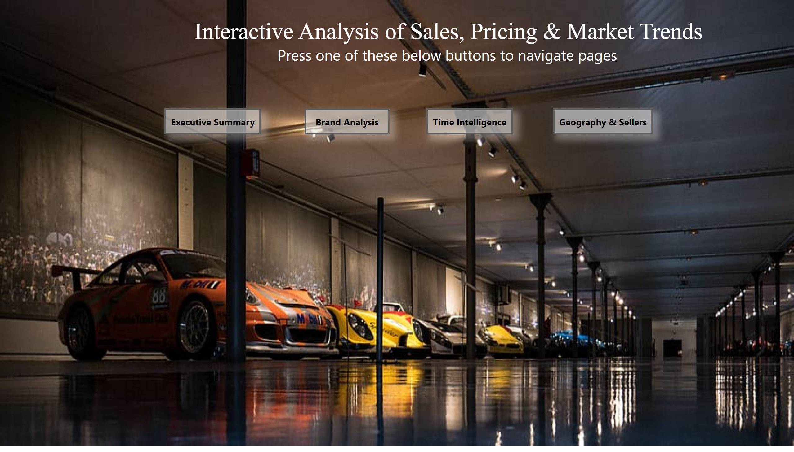
Welcome page
Notes:
actionButton
No alt text provided
actionButton
No alt text provided
actionButton
No alt text provided
actionButton
No alt text provided
textbox
No alt text provided

Slide 3
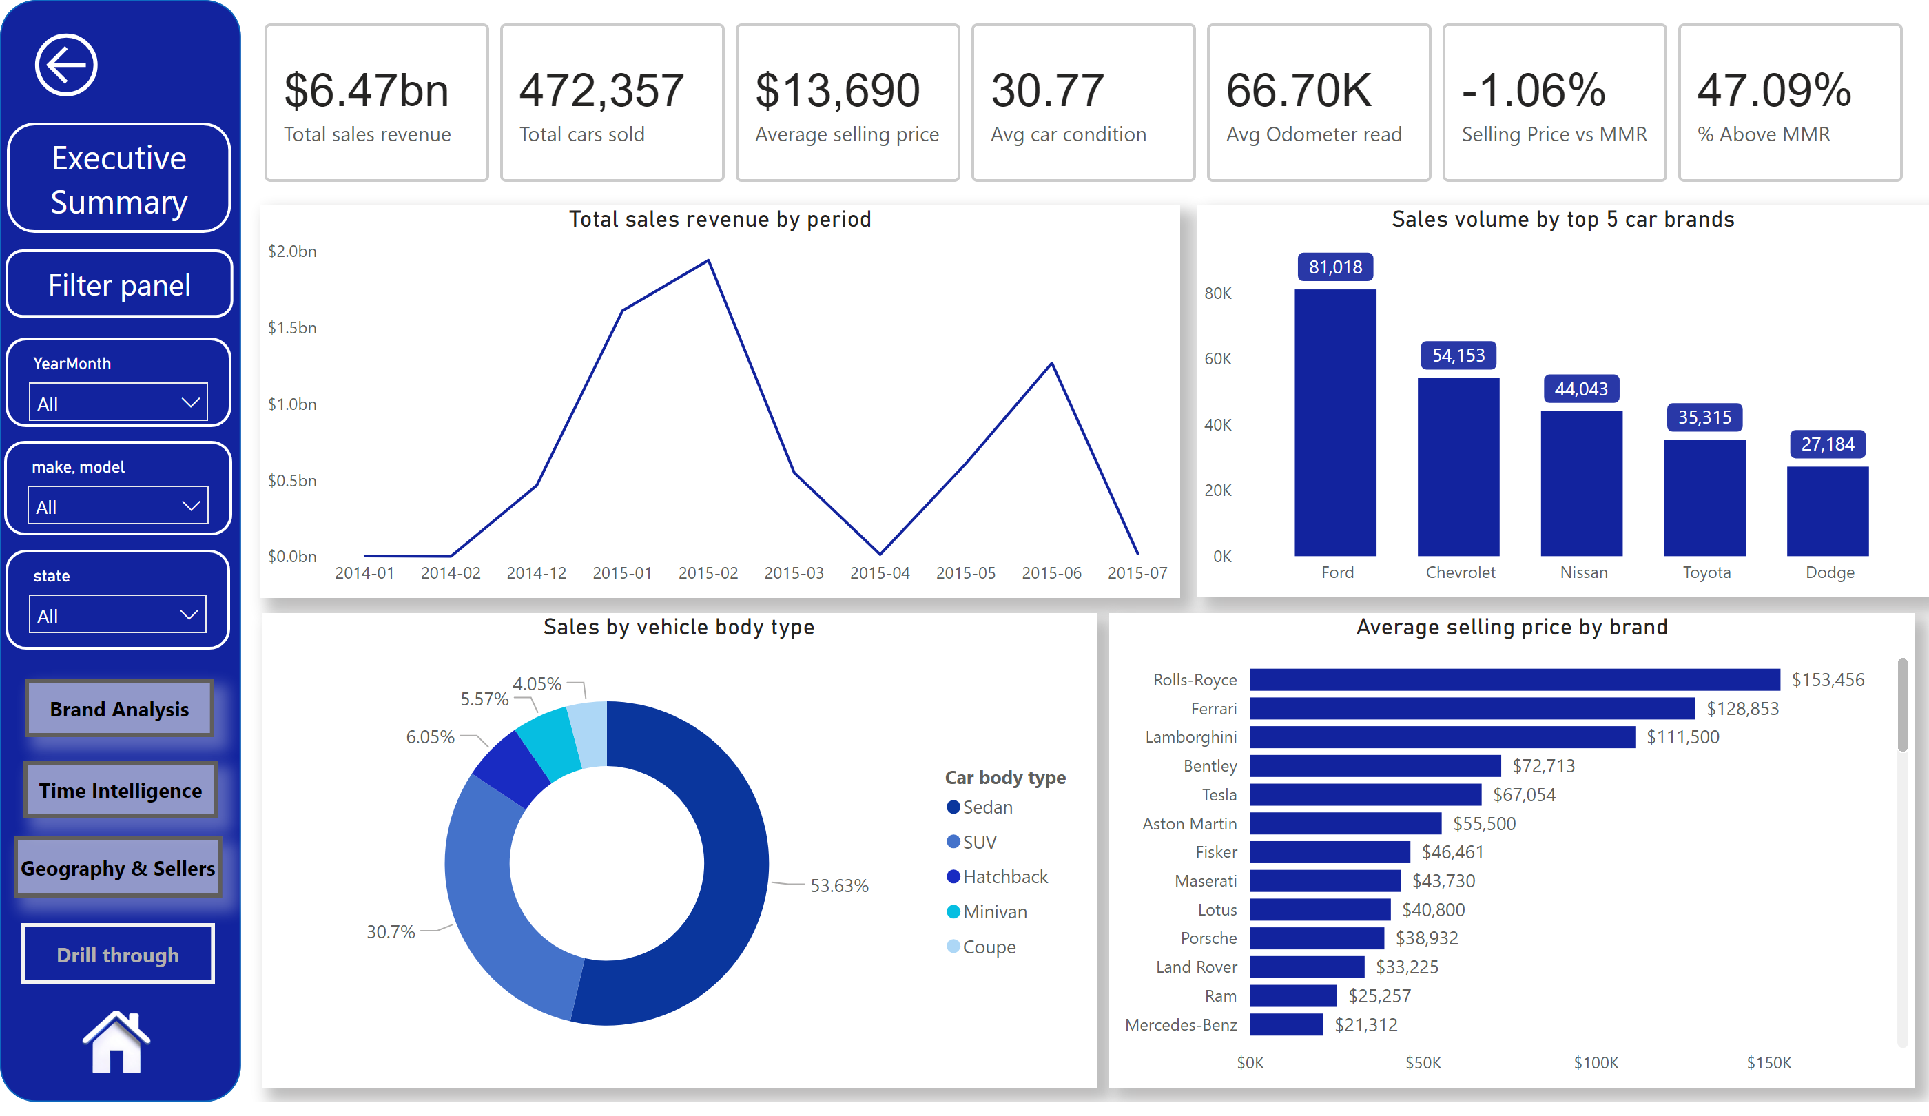
Executive Summary
Notes:
cardVisual
No alt text provided
Total sales revenue by period
No alt text provided
Sales volume by top 5 car brands
No alt text provided
Sales by vehicle body type
No alt text provided
shape
No alt text provided
slicer
No alt text provided
slicer
No alt text provided
slicer
No alt text provided
clusteredBarChart
No alt text provided
actionButton
No alt text provided
actionButton
No alt text provided
shape
No alt text provided
shape
No alt text provided
image
No alt text provided
actionButton
No alt text provided
actionButton
No alt text provided
actionButton
No alt text provided

Slide 4
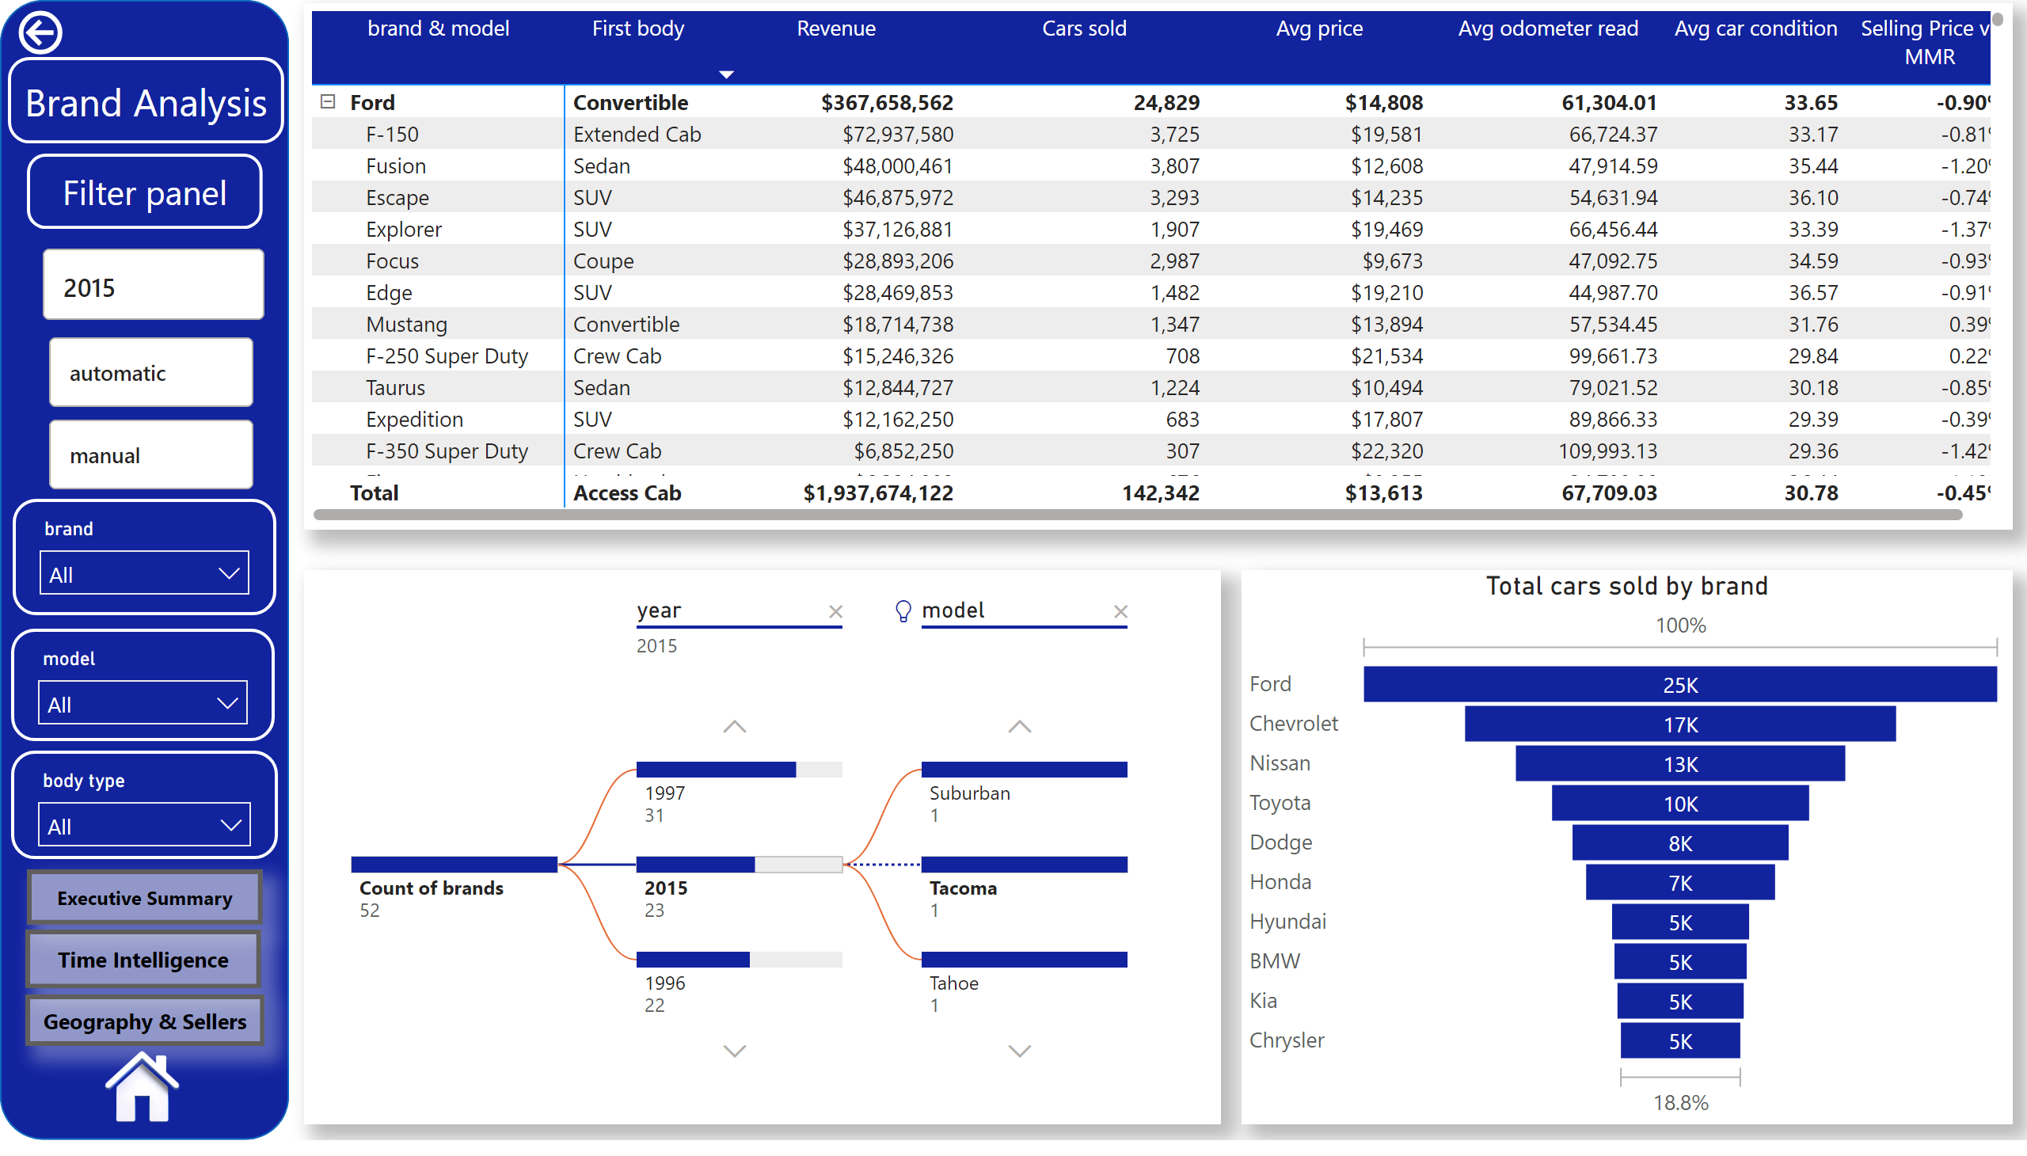
Brand Analysis
Notes:
advancedSlicerVisual
No alt text provided
advancedSlicerVisual
No alt text provided
pivotTable
No alt text provided
actionButton
No alt text provided
decompositionTreeVisual
No alt text provided
funnel
No alt text provided
slicer
No alt text provided
slicer
No alt text provided
slicer
No alt text provided
shape
No alt text provided
shape
No alt text provided
shape
No alt text provided
image
No alt text provided
actionButton
No alt text provided
actionButton
No alt text provided
actionButton
No alt text provided

Slide 5
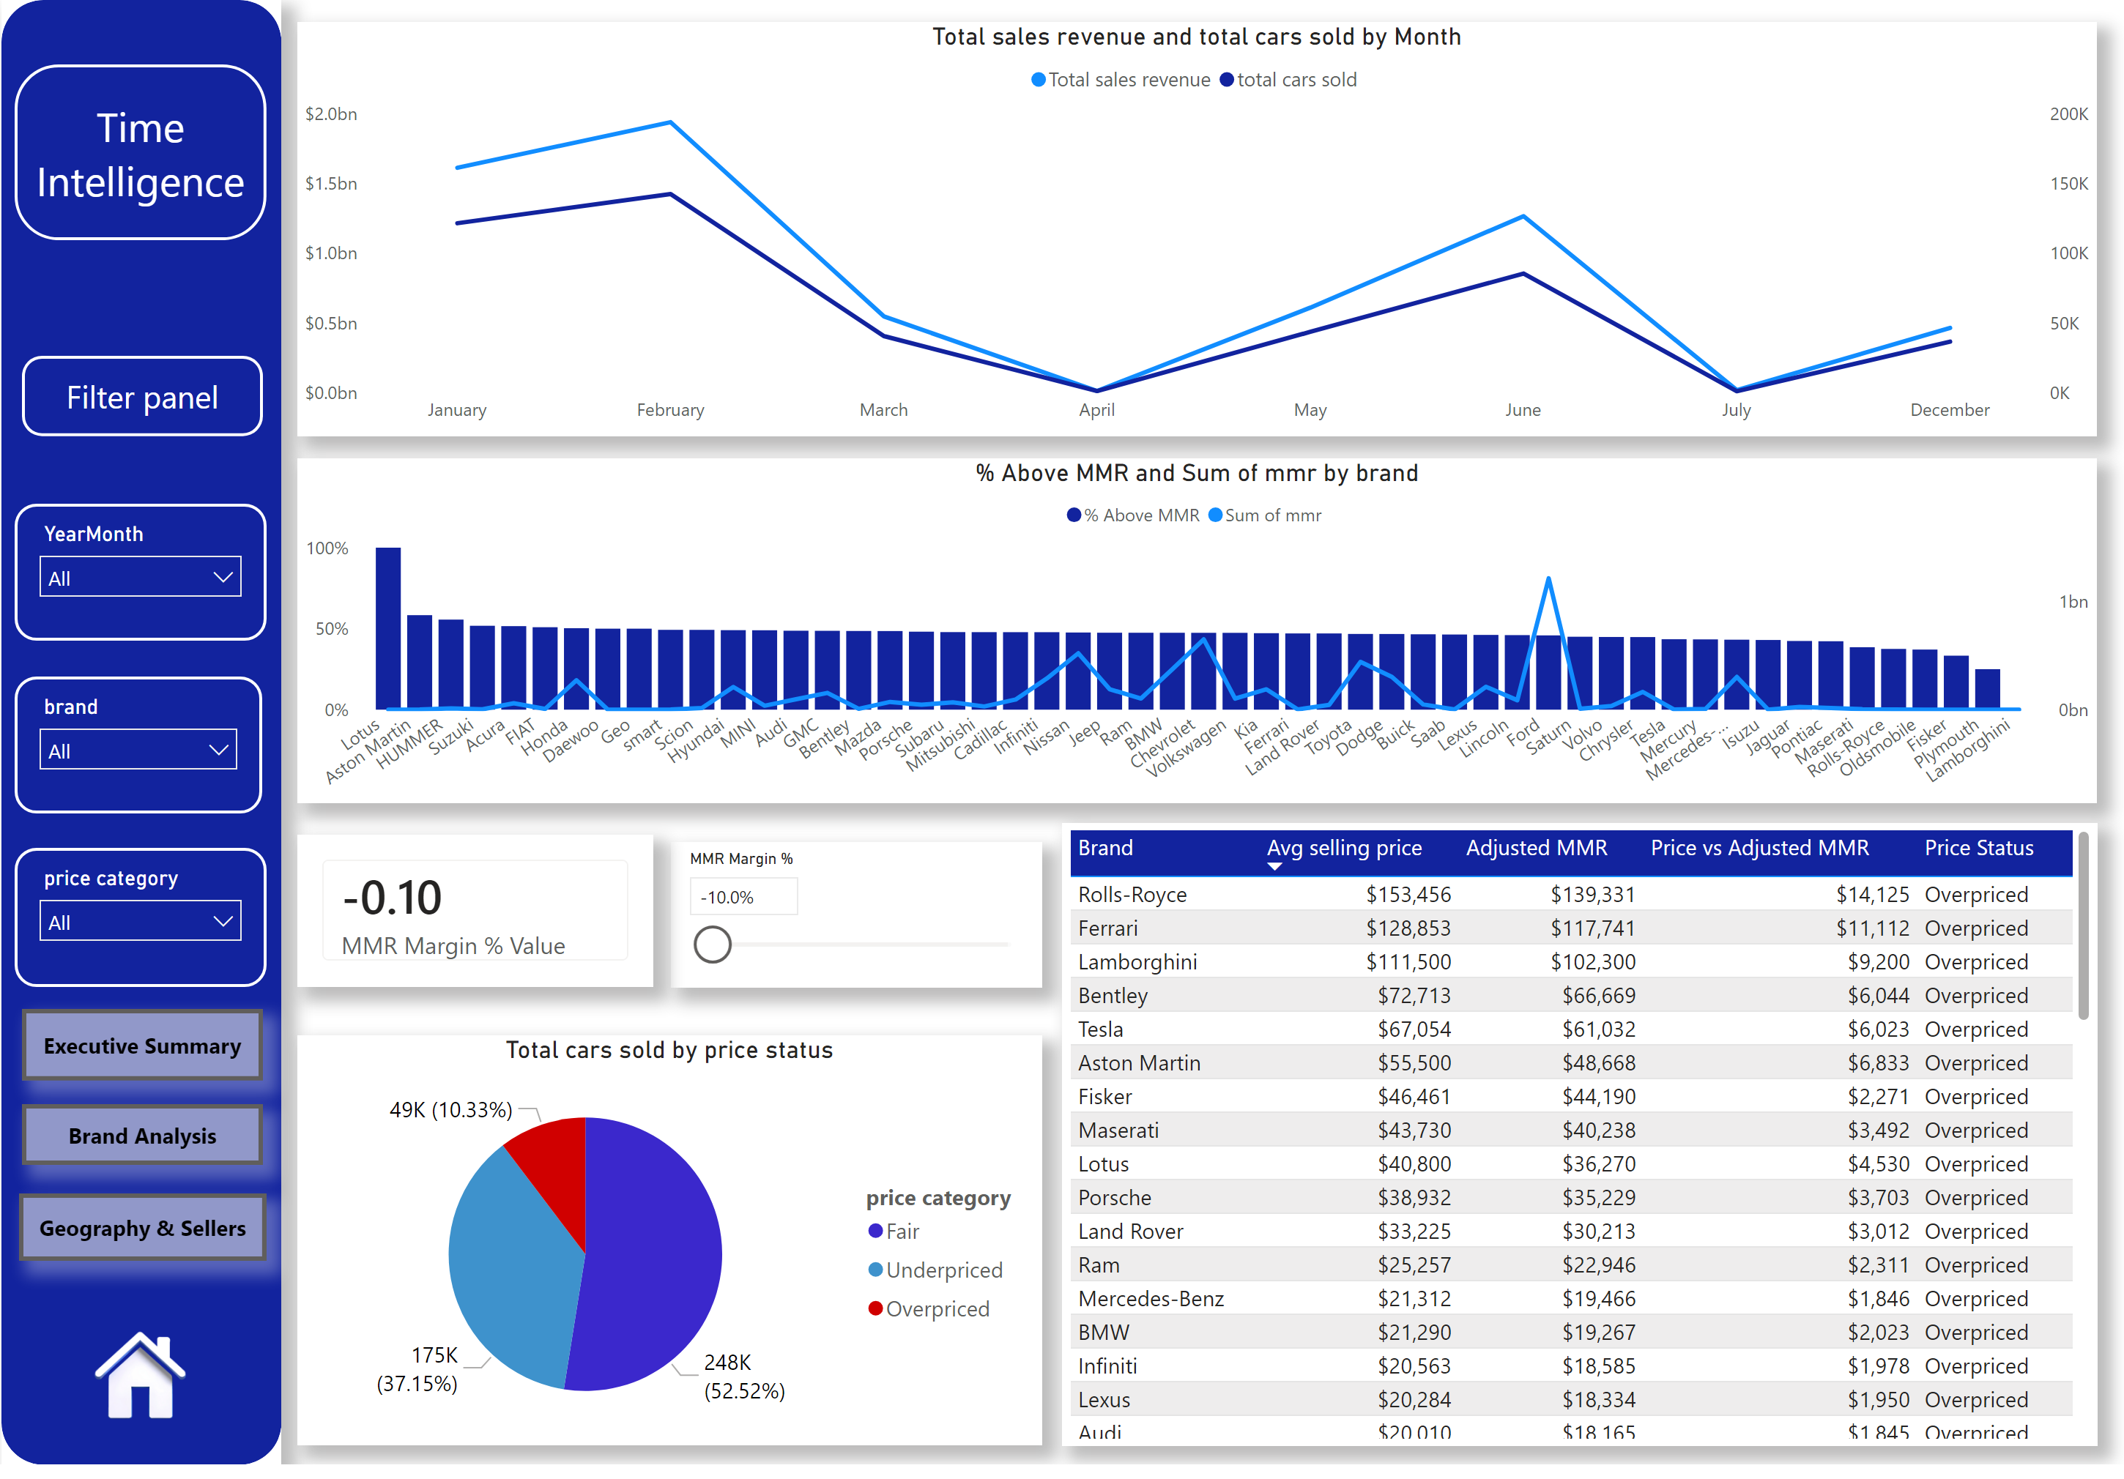
Time Intelligence
Notes:
slicer
No alt text provided
slicer
No alt text provided
slicer
No alt text provided
lineChart
No alt text provided
lineStackedColumnComboChart
No alt text provided
Total cars sold by price status
No alt text provided
slicer
No alt text provided
cardVisual
No alt text provided
tableEx
No alt text provided
shape
No alt text provided
shape
No alt text provided
shape
No alt text provided
image
No alt text provided
actionButton
No alt text provided
actionButton
No alt text provided
actionButton
No alt text provided

Slide 6
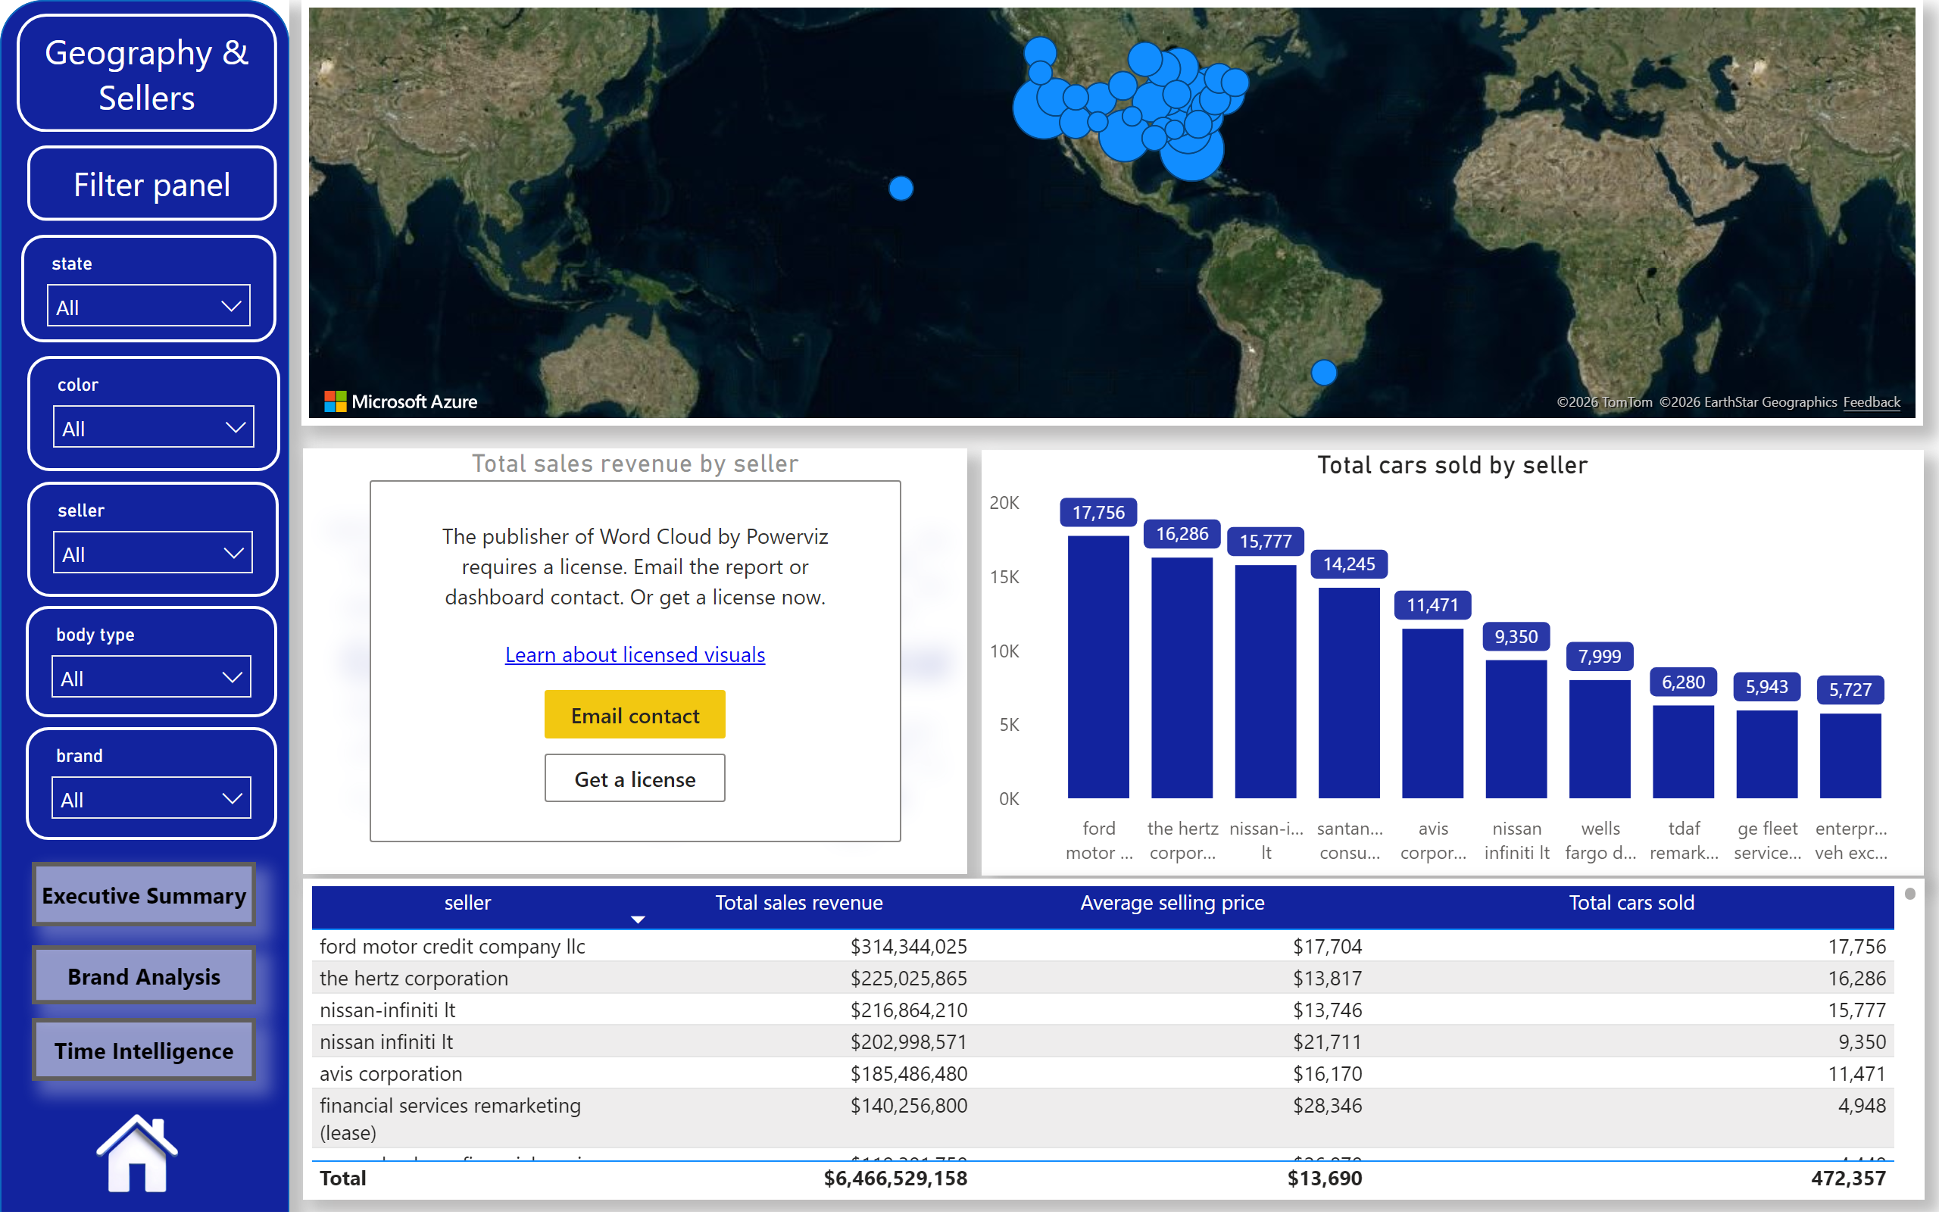
Geography & Sellers
Notes:
slicer
No alt text provided
azureMap
No alt text provided
WordCloud5550983e166911eebe560242ac120002
No alt text provided
slicer
No alt text provided
slicer
No alt text provided
slicer
No alt text provided
columnChart
No alt text provided
tableEx
No alt text provided
slicer
No alt text provided
shape
No alt text provided
shape
No alt text provided
shape
No alt text provided
image
No alt text provided
actionButton
No alt text provided
actionButton
No alt text provided
actionButton
No alt text provided

